Slide 1
Prototype RWIS Alert System
By: Senior Design Team
Hayden Pride, Nick Steilman, Quinn Cox

Slide 2
Introduction

Slide 3
Introduction To WeatherShare
WeatherShare is the principal repository for the storage and viewing of California Department of Transportation (Caltrans) Road Weather Information System (RWIS) data
The system is primarily used by Caltrans personnel, but it can also be accessed by the public by viewing
The system is used to plan and manage winter operations and maintenance
WeatherShare utilizes map-based and tabular interfaces to display RWIS sensor information
WeatherShare can be accessed at http://www.weathershare.org/
Notes:
Quinn Cox

Slide 4
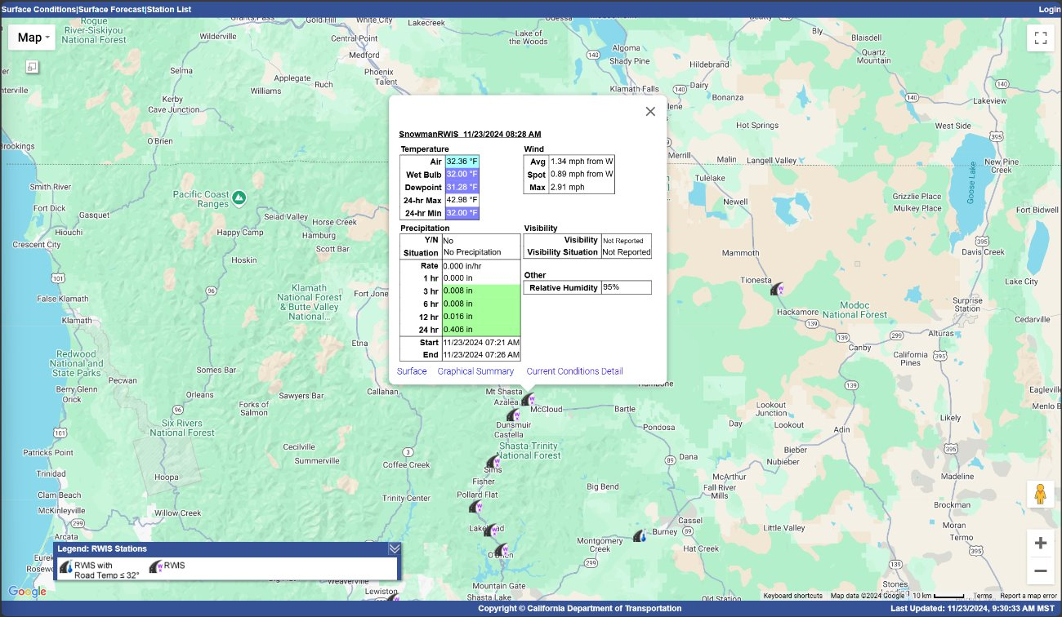
WeatherShare Map Interface
Notes:
Quinn Cox

Slide 5
Timeline (Fall 2025)
Review Current System (September 26)
Workplan (October 3)
Strawman Document (October 17)
Development Environment (October 17)
Software Requirements Specification (October 31)
Design Document (November 14)
Presentation Draft (November 25)
Final Design Presentation (December 1-5)
Notes:
Hayden Pride: This is our current project timeline. In the fall semester we focused on document and design. We started with a strawman or concept document which consisted of the basic idea behind the project. We moved into our software requirements specification which covered all functional and non-functional requirements of our prototype system. We then moved to the design document, which covered the design of the requirements in detail. Lastly, we have our presentation of our project and documentations.

Slide 6
Timeline (Spring 2026)
Initial Development of Prototype System Complete (February 13)
Installation and Implementation Guide (February 13)
Implement/Test Prototype System (February 27)
Final Version of Prototype System (February 27)
System Documentation (March 6)
Final Presentation (March 23-27)
TechXPo Poster Presentation (April 23)
Final Journal Document (April 30)
Notes:
Hayden Pride: This will be the future timeline for next semester. These dates are not solidified but should be very close to when we plan to have things done. We will start with initial development, move to installation, testing and completion of the final version. We will finish up documentation and present our final project at TechXPo.

Slide 7
Prototype Alert System
The Alert System will allow users to login through WeatherShare, choose specific threshold values for sensor readings to facilitate the sending an alert notification on timing specifications decided by the user.
The System will rely on Caltrans CSV (Comma Separated Value) files to receive sensor readings and determine whether they have reached a threshold value
The System will not perform actual notifications, but will provide a feed that can be used by a separate subsystem to disseminate notifications
Notes:
Nick Steilman

Slide 8
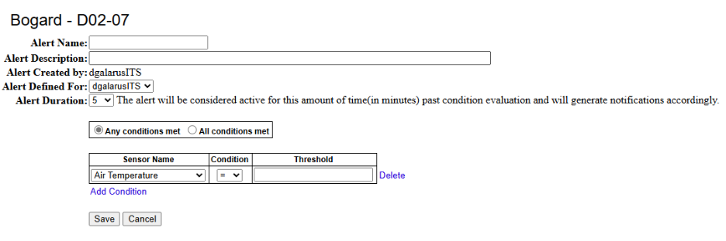
Prototype RWIS Alert System Interface
Notes:
Nick Steilman

Slide 9
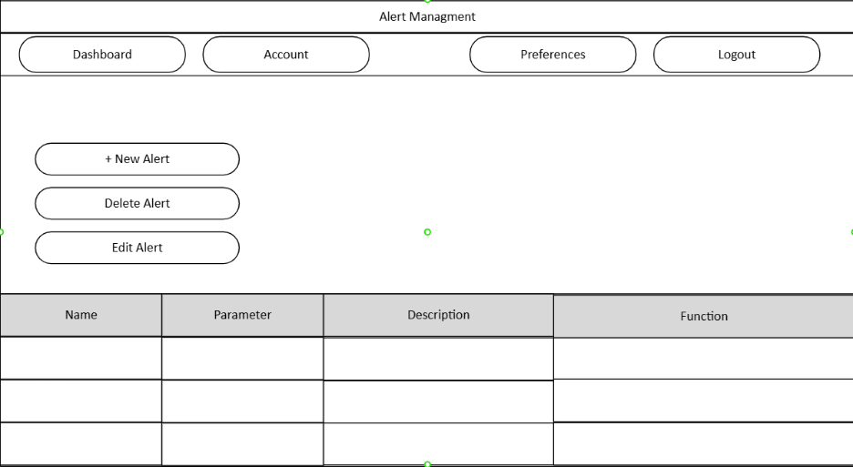
Prototype RWIS Alert System Wire Frame
Notes:
Nick Steilman

Slide 10
Scope

Slide 11
Scope Definition
The scope of the Senior Design Project is to design an application that facilitates the creation, storage, processing of alerts, and facilitates the dissemination of alert notification based on real-time RWIS data.
The project includes both front- and back-end components. Front end will be an interface developed to allow users to create and manage profiles, define alerts by setting threshold values for sensor readings, and view processed data.
The back-end will rely on an SQLite database to store user profile information and alert parameters set by users.
Notes:
Hayden Pride: This is an outline of the overall scope of our Senior Design project. The primary goal of this system is to build an application that can create, store, process, and send alerts based on real-time RWIS sensor data. RWIS (Road Weather Information System) provides continuous weather and roadway condition measurements, and out system will use those incoming sensor readings to determine when specific conditions cross thresholds defined by users. When that happens, the system generates alerts automatically. The project scope includes both front- and back-end components. On the front-end, we’re designing an interface where users can log in, create, manage, and configure custom alerts, such as air temperature and wind speed. Users will also be able to view weather data. On the back-end, all user information and alerts will be stored in an SQLite database.

Slide 12
Scope Definition
Python functions will be written to process weather condition data obtained from Caltrans CSV files. Functions will include parsing inputs, validating the data, and performing unit conversions to present the data in human-friendly conventions.
A separate subsystem will be responsible for alerting users via email or SMS when conditions are met. The Prototype System will provide a feed that can be used by the subsystem to enable timely notifications to users.
This project is contained to software development only, with no modifications to Caltrans or WeatherShare.
Notes:
Hayden Pride: Focusing on the data processing and alerting components, we’ll start by developing Python functions to handle the raw RWIS data provided by Caltrans in CSV formats. These functions will parse and clean the incoming data, which validates that the sensor readings are complete and accurate, and convert units when necessary, so that data is human-friendly. The notification subsystem will be a separate entity but will be a closely integrated component of the design. This project is contained only to software development and will not modify Caltrans or Weathershare.

Slide 13
Requirements
3.1.3.1 Users shall access The System via web browser.
3.1.3.2 Users shall access The System exclusively via the Internet.
3.1.4.1 The System shall generate and display internal alerts based on user-defined weather condition thresholds but shall not send external alerts (e.g., emails, SMS, or third-party messages).
Notes:
Quinn Cox

Slide 14
Requirements Continued.
3.2.2.1 The System shall retrieve RWIS data and metadata from the CWWP2 online portal.
3.2.2.2 The System shall add processed data into a temporary data file until all sensor readings have been processed.
3.2.3.1 The System shall store User credentials and User defined parameters in an SQLite database.
3.2.4.1 Users shall view current and recent conditions, as reported by RWIS, via a tabular interface.
3.3.1.1 Alerts shall be defined based exclusively on RWIS data.
Notes:
Quinn Cox

Slide 15
Requirements Continued.
3.3.1.4 Conditions shall be defined using comparison operators: less than, less than or equal to, equals, greater than or equal to, greater than, not equal to, between (inclusive range), between (exclusive range).
3.3.2.1 Alert conditions shall be evaluated when new RWIS sensor readings are read by The System.
3.4.1.1 The System shall retrieve new data from external sources to correspond with update schedules for those sources.
3.4.1.2 The System shall recognize and immediately process data retrieved by The System from external sources.
3.4.4.1 Upon the addition, modification, or deletion of an alerts, The System shall not require significant alteration (no system reboot or recompilation of source code is required).
3.4.4.4 The RWIS Subsystem shall read, extract, preprocess, and store data in a way that is intuitive and easy to manage.
Notes:
Hayden Pride: Requirement 3.3.1.1 defines the compariso

Slide 16
Requirements Continued.
3.5.1.1 The application shall be available via commonly available, recent versions of web browser software running on a desktop or laptop PC platform.
3.5.1.2 The application shall pull in data from specific sources and provide that data to user groups via web-based protocols.
3.5.3.1 The System’s web interface shall be implemented using HTML5, CSS, and JavaScript and shall display RWIS data and alert conditions through an interactive browser-based dashboard.
3.5.4.1 The application shall allow authorized users to configure weather condition thresholds, select RWIS stations, and view resulting alerts through an interactive web interface.
Notes:
Hayden Pride: Requirement 3.5.1.1 states that the application has to be commonly available. Ours will be available to any modern web browser on a standard desktop or laptop. 3.5.1.2 says that data will come from specific sources, like RWIS CSV files, and be delivered to users through web-based protocols. 3.5.3.1 defines the technologies used and how it will be displayed. 3.5.4.1 says that users are able to configure their own alerts and view them on the web interface.

Slide 17
Standards
Where applicable, we will identify and follow the appropriate IEEE standards, as well as other project-specific standards.
We understand that we may not be able to have full conformance with the following standards and others covering the software engineering/development process in the scope of a one-year senior design project.
A best effort shall be made to identify and apply appropriate standards to the project.
Notes:
Nick Steilman

Slide 18
Standards
IEEE Standard for Software and System Test Documentation, IEEE 829-2008. https://ieeexplore.ieee.org/document/4578383
IEEE Standard for Information Technology-Systems Design--Software Design Descriptions, IEEE​
1016-2009. https://standards.ieee.org/ieee/1016/4502/
ISO/IEC/IEEE International Standard - Systems and software engineering -- Life cycle processes --Requirements engineering, IEEE/ISO/IEC 29148-2018. https://standards.ieee.org/ieee/29148/6937/
NTCIP 1204, Environmental Sensor Station Interface Standard: http://www.ntcip.org/library/standards/default.asp?documents=yes&standard=1204
Notes:
Nick Steilman

Slide 19
Design

Slide 20
Design Introduction
Front End: All user interactions such as log on, alert creation, and displaying data will be handled by a web-based interface using a locally hosted server.
Back End: Python will be used for data retrieval and alert evaluation. An SQLite database will be used to store alert definition and relevant weather data.
Notes:
Nick Steilman

Slide 21
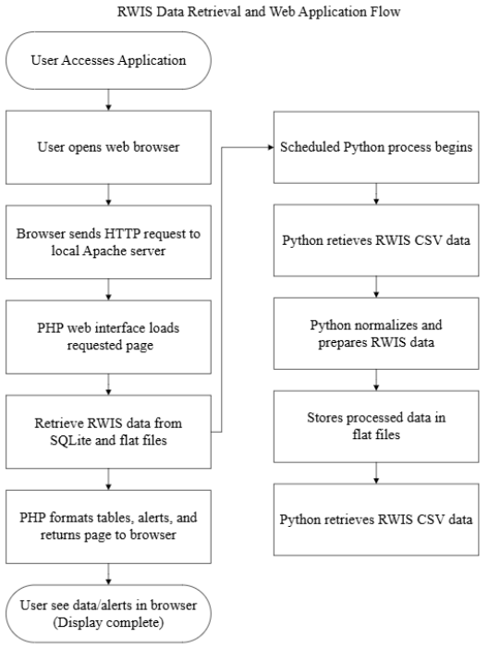
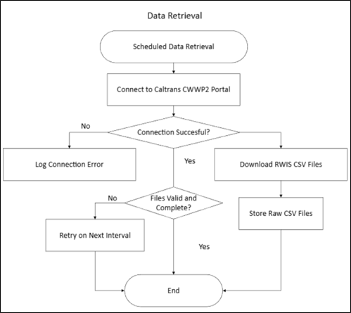
Flow Diagrams
Notes:
Hayden Pride: These are two major process flow diagrams that make up our system. First, we have the automated data retrieval workflow. At scheduled intervals, the system attempts to connect to the CWWP2 portal. If the connection is unsuccessful, the failure is logged and will try again at the next interval. If successful, the system downloads the RWIS CSV files and checks whether the files are valid and complete. Any invalid files are rejected and retried later. Valid data will be stored in its raw form to be process further. The next diagram shows end-to-end data flow from the user’s perspective. A user opens the application, and a request is sent to a server. The PHP web interface retrieves processed data and returns that information to the user. In parallel, a scheduled Python process runs in the background. The Python component retrieves the RWIS CSV data, cleans it, and then stores the processed results. These diagrams represent how data moves through the system and how the systems communicate.

Slide 22
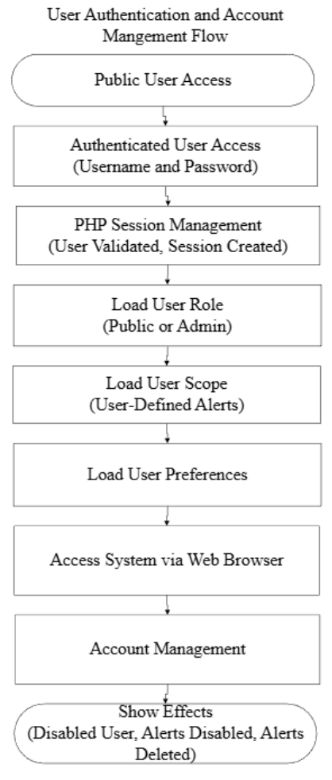
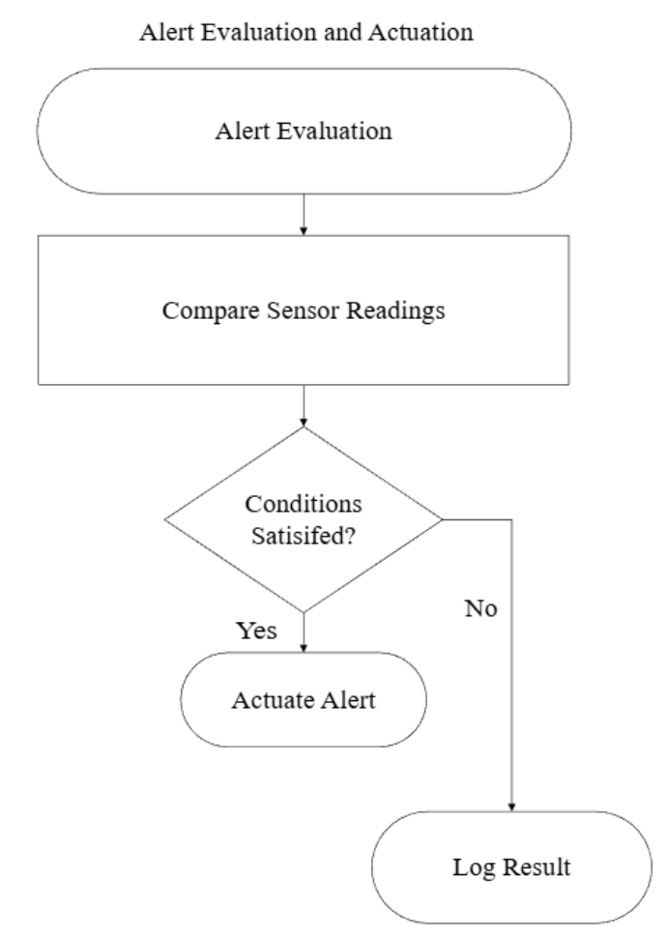
Flow Diagrams
Notes:
Hayden Pride:

Slide 23
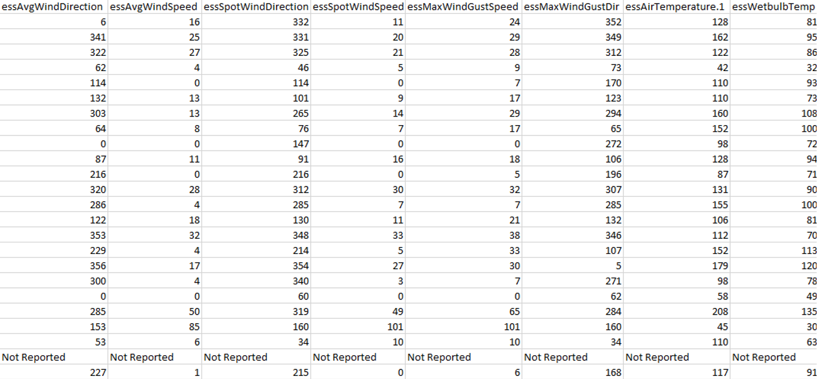
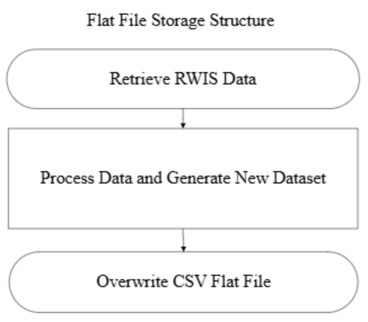
Data: Raw
Example of what data looks like before processing:
Notes:
Quinn Cox

Slide 24
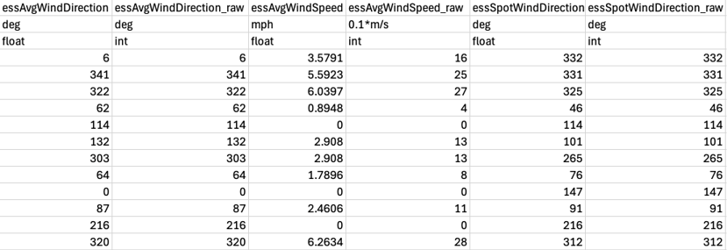
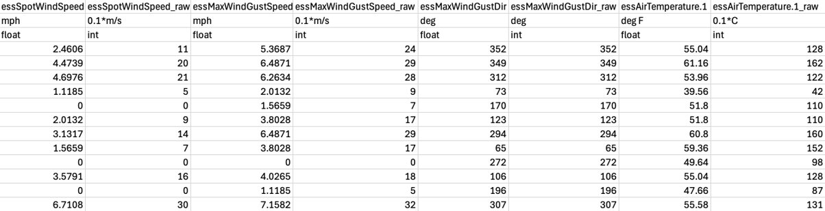
Data: Processed
Notes:
Quinn Cox

Slide 25
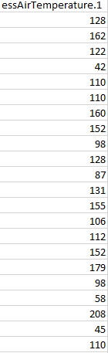
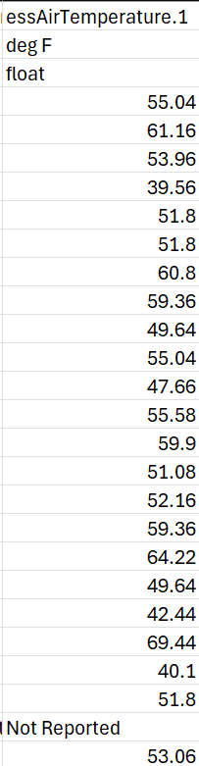
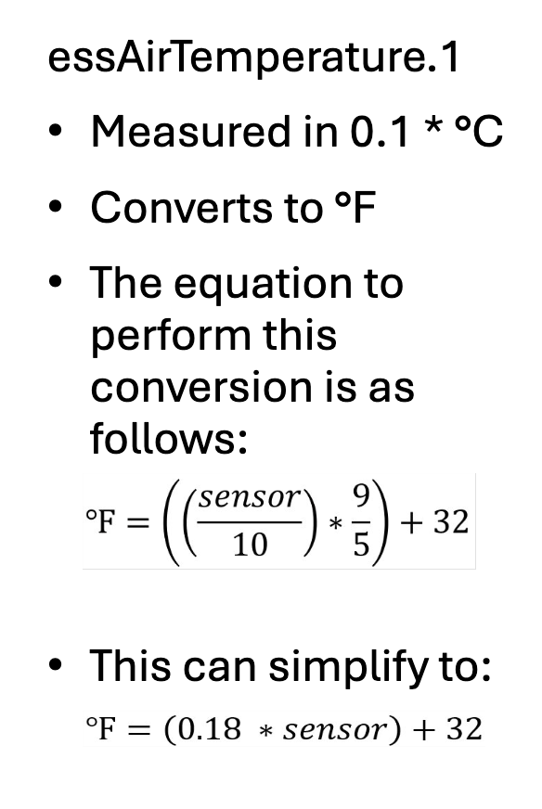
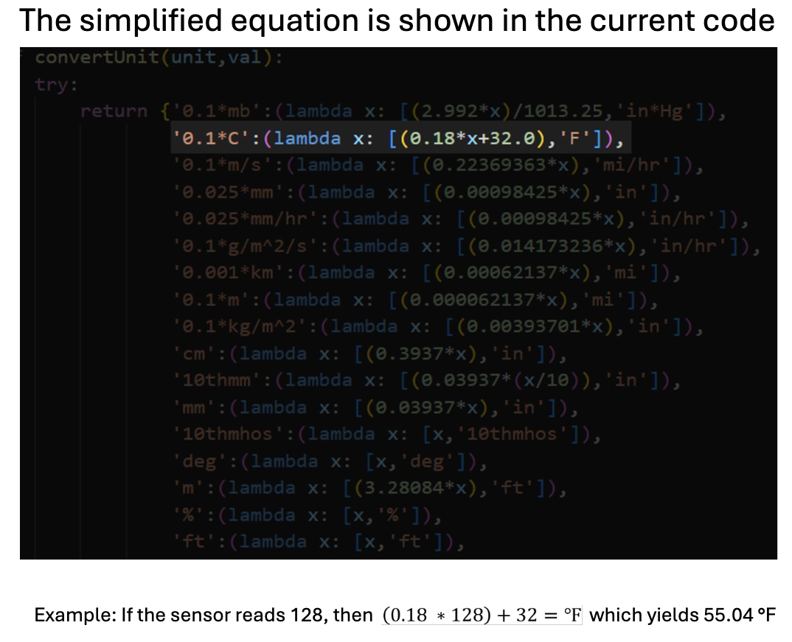
Converting Example Data
Notes:
Nick Steilman

Slide 26
Summary
The program reads the most recent sensor readings from the CSV flat file. It then retrieves all user-defined alert conditions from the SQLite database. The program then compares the current values against the conditions. If conditions are met (e.g., "37 > 35"), the alert is "actuated". All evaluation results (actuations, no change, etc.) are logged.
Notes:
Nick Steilman

Slide 27
Questions?

